Slide 1
Apache Kafka
Kafka – Key Concepts

Slide 2
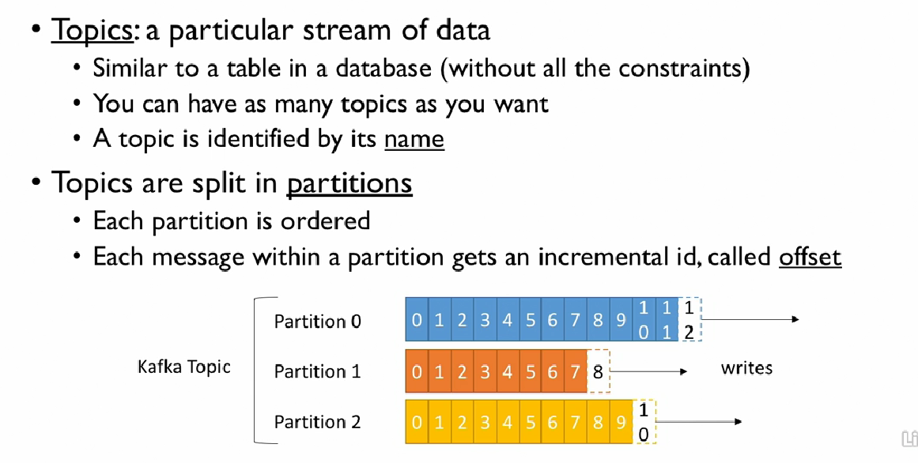
Topics, Partitions & Offsets

Slide 3
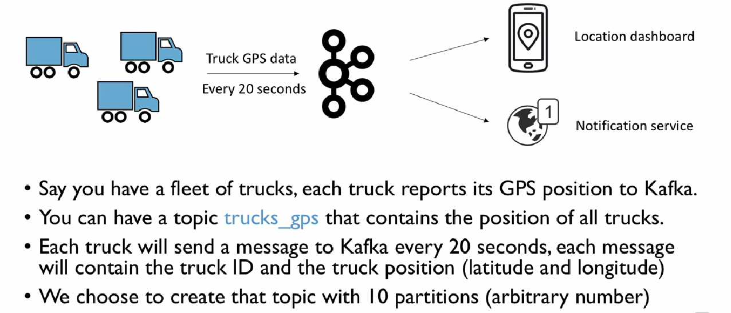
Example: Fleet

Slide 4
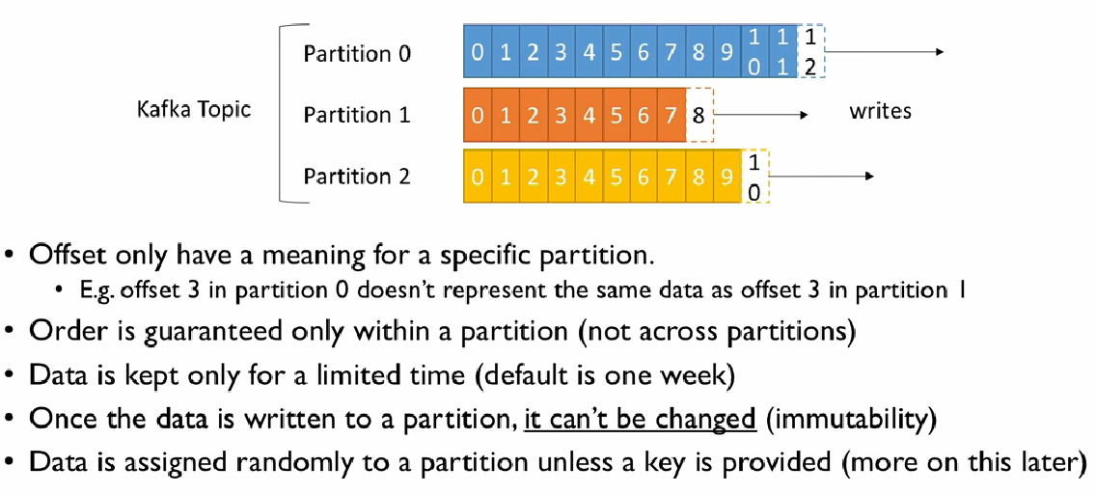
Topics, Partitions & Offsets

Slide 5
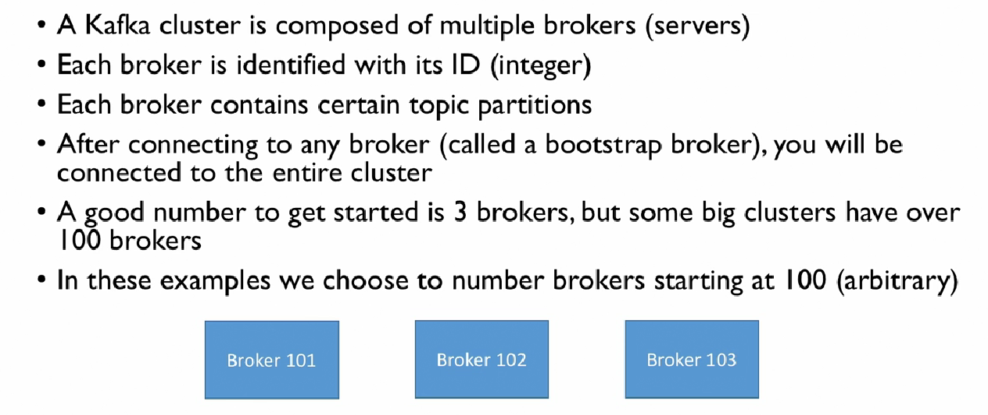
Brokers

Slide 6
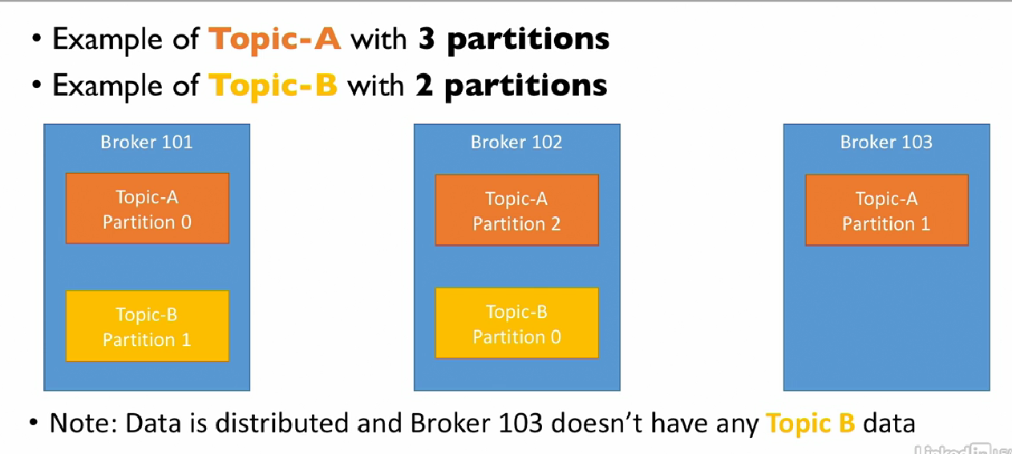
Brokers, Topics & Partitions

Slide 7
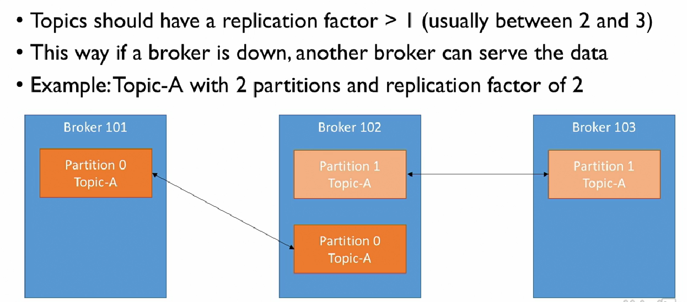
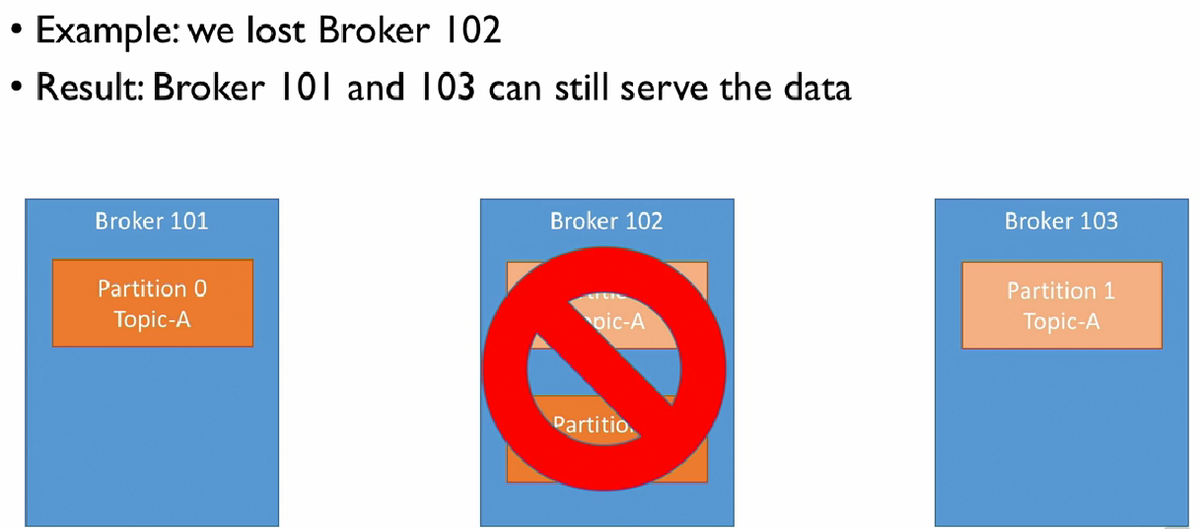
Replication Factor

Slide 8
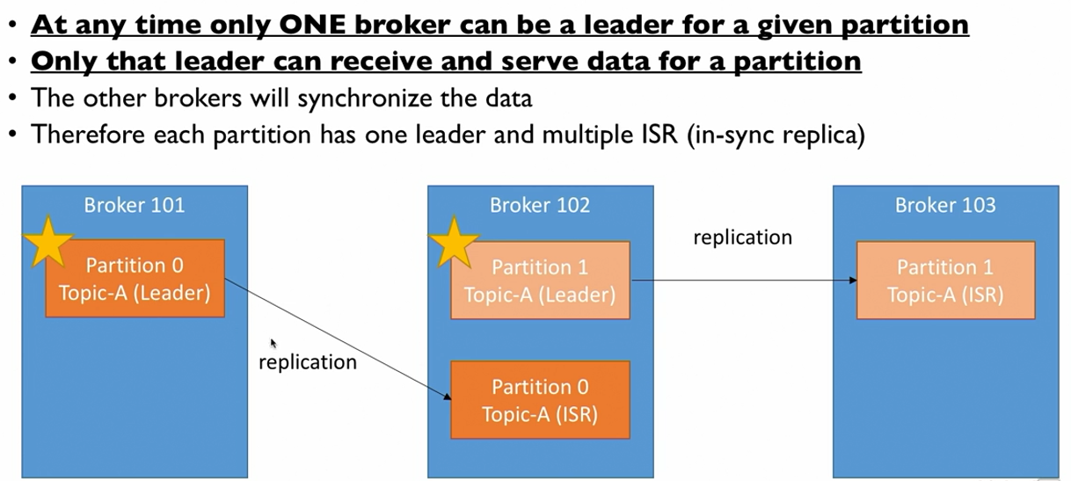
Arbitration/Leader Selection
ZooKeeper determines this process.

Slide 9
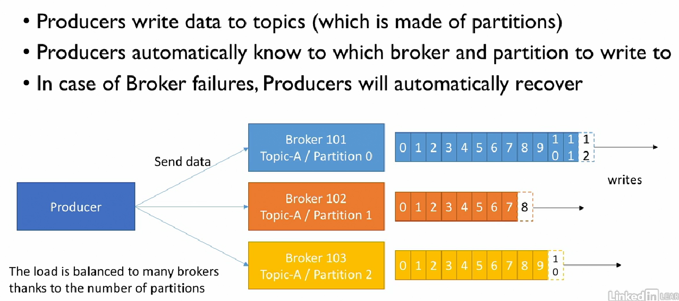
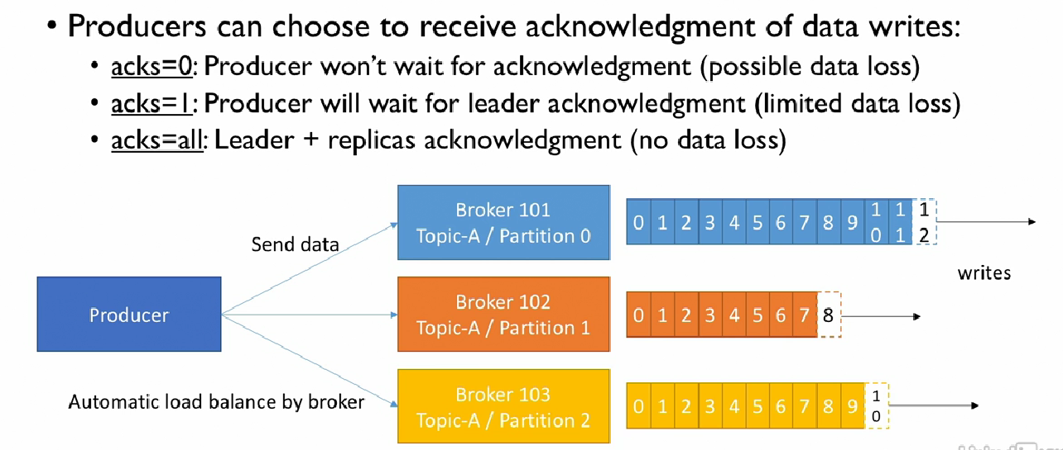
Producers
Sending message without keys will go through a round-robin before being written to a partition

Slide 10
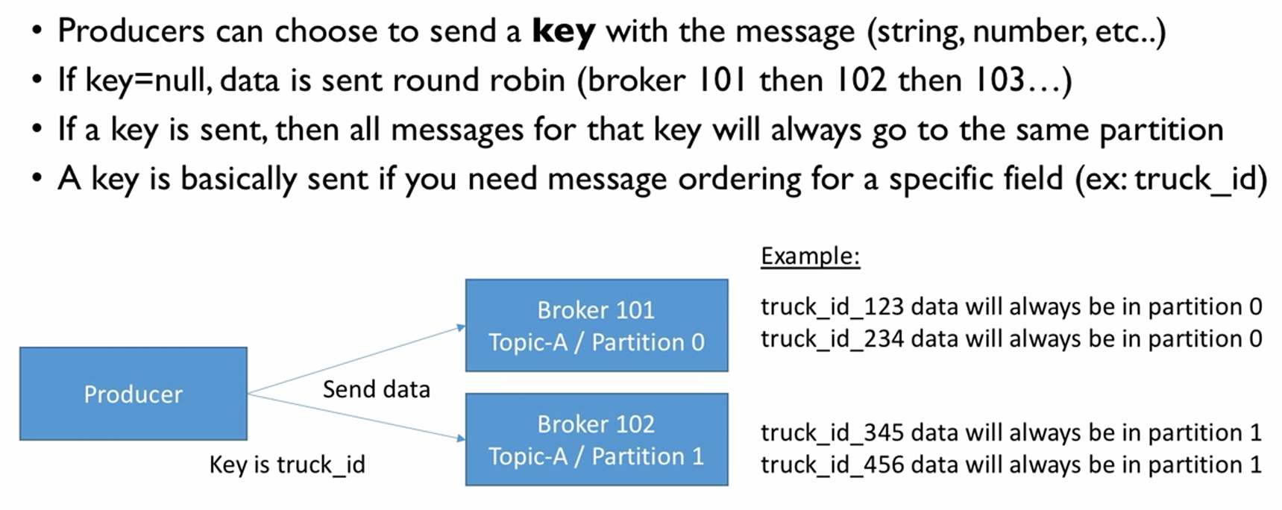
Message Keys and Ordering
This is guaranteed via key hashing, which depends on number of partitions

Slide 11
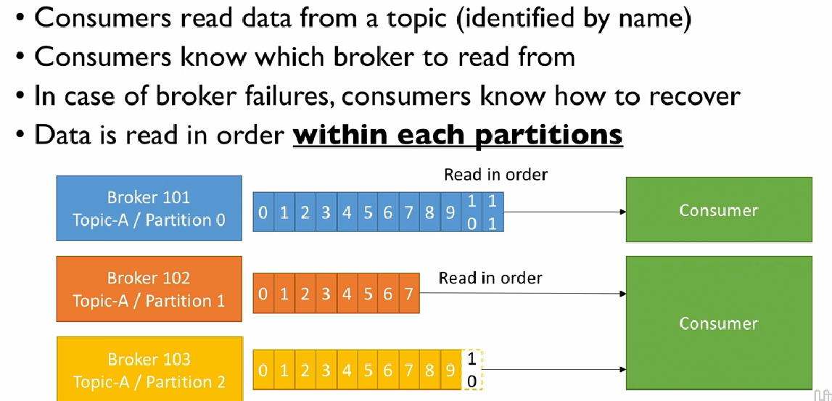
Consumers

Slide 12
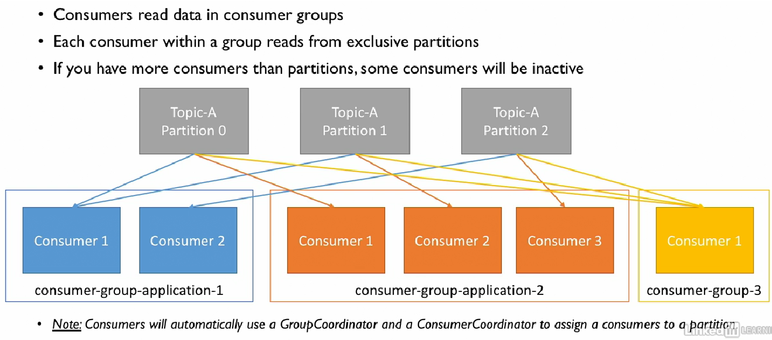
Consumer Groups

Slide 13
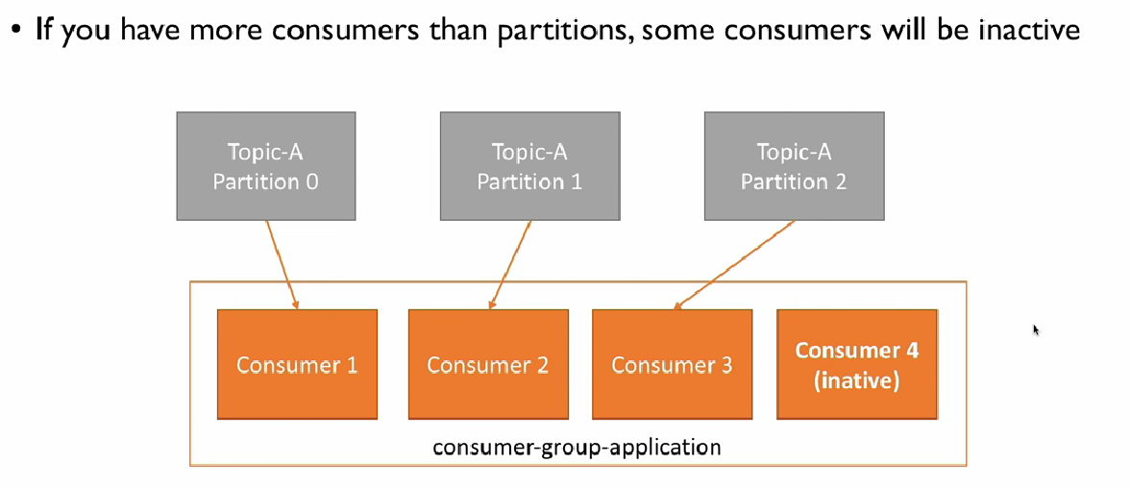
Why do you need more consumers
If Consumer 3 goes down, you can have consumer 4 taking over.

Slide 14
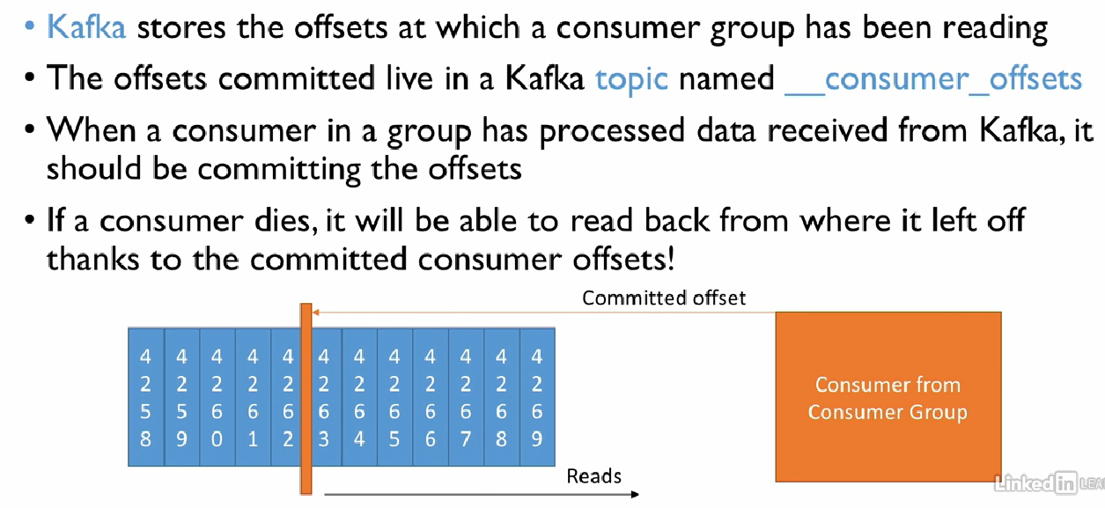
Consumer Offsets (Bookmarks)

Slide 15
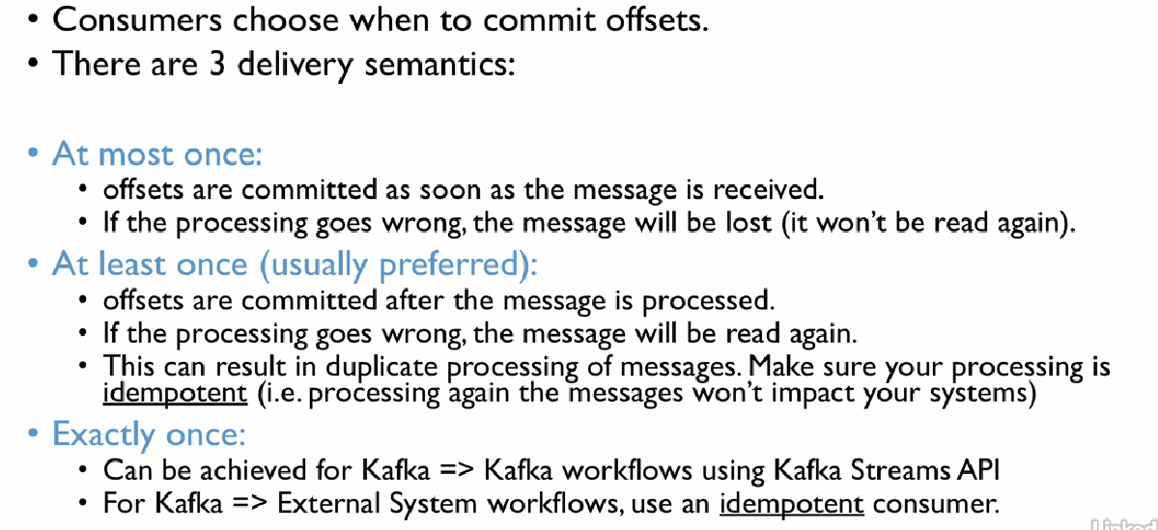
Consumer delivery symantics

Slide 16
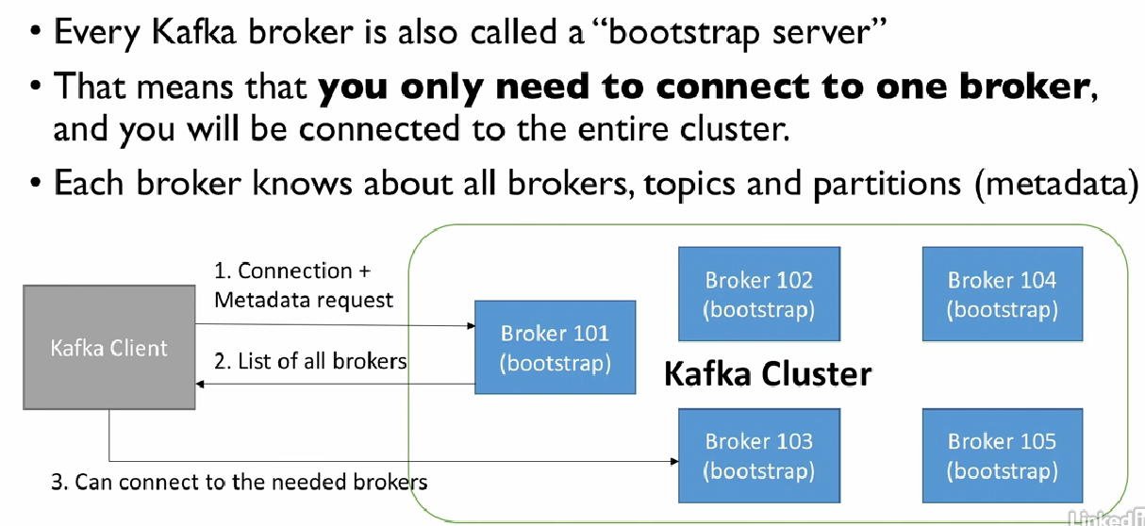
Broker Discovery
Implemented automatically.

Slide 17
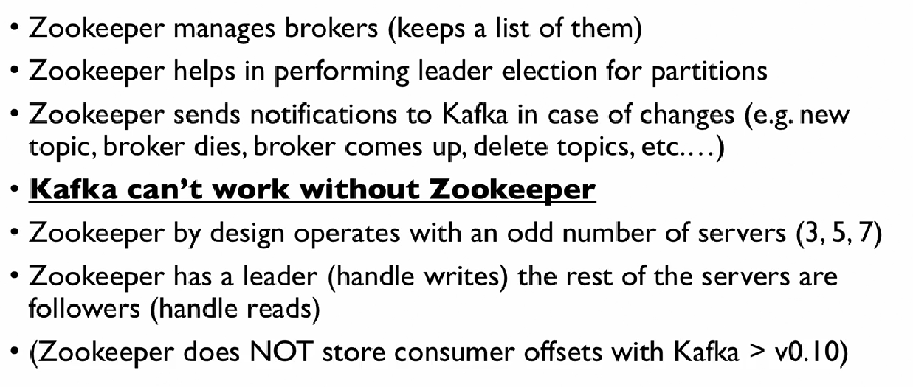
Zookeeper

Slide 18
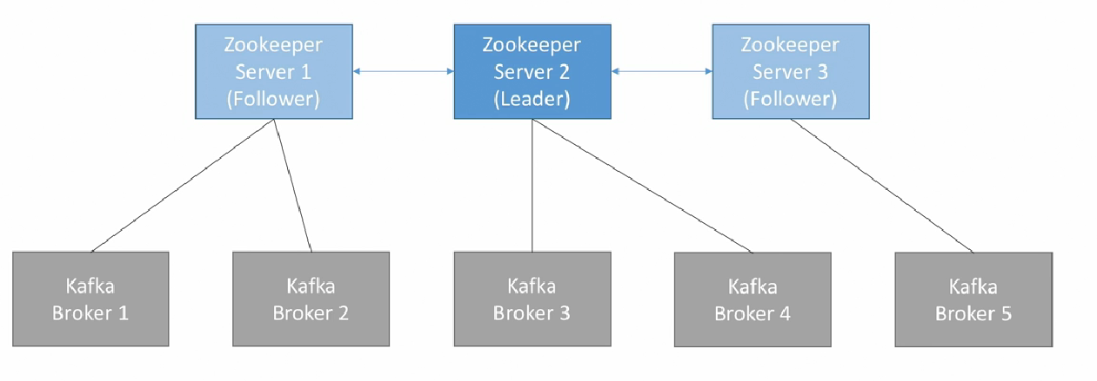
Zookeeper

Slide 19
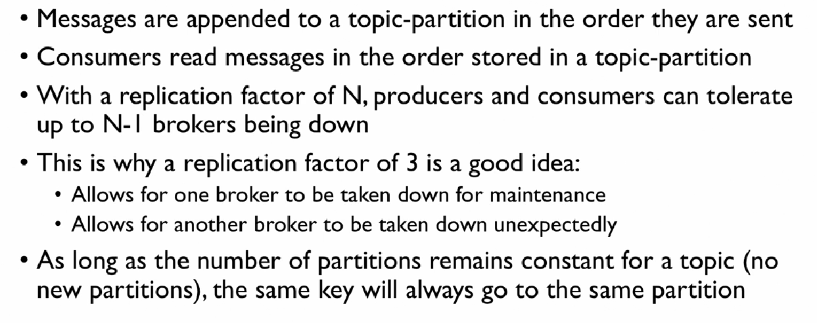
Kafka Guarantees

